Slide 1




DIBBs Brown Dog Adding Converters

Slide 2

Brown Dog Architecture
Web Browser (BDFiddle)
Clients
(e.g. bdcli)
HTTP/HTTPS
RabbitMQ (Event Bus)
HTTP/HTTPS
Fence (API Gateway)
NGINX (Load balancer)
NGINX (Load balancer)
Polyglot
…
Polyglot
Clowder
Clowder
…
MongoDB
MongoDB (Data, Metadata)
Converter (Software Server)
Converter (Software Server)
Extractor
Extractor
…
…
Conversions
Extractions
Notes:
We show here the architecture of the Brown Dog services: i) The DTS is built on top of the Clowder framework which is a web-based content management system. Using the DTS REST API, a user can upload a file/dataset or url to a file to the DTS. This triggers specific extractors based on appropriate MIME types, for extraction of metadata, signatures or any derived product from the file’s content. Inside DTS, there is a distributed messaging bus, RabbitMQ, which reliably distribute and manage job execution by placing messages in a queue for each extractor, and removing them when job done. Extractors listens to the RabbitMQ for new messages for extraction. It saves all input files, dataset and outputs in MongoDB. Extractors can be written in any language as longs as it can communicate with RabbitMQ and Clowder REST interface via HTTP – Java, Python, Scala, C/C++. Extractors are deployed within distributed cloud environment.
Data Access Proxy, It is built on top of the Polyglot framework and provides REST API allowing users and applications to use its conversion capabilities. One of the key component is Software Server which hosts one or more applications. It uses light weight wrapper script to automate specific functionalities within the application and then provide access to it via a consistent REST API. Software Server listens a RabbitMQ bus for any conversion jobs and has a queue for each software it controls. DAP polyglot head node monitors the RabbitMQ bus and queries for all available Software Servers and the software’s input and output formats it supports. It constructs a Input/Output graph, finds the shortest conversion path between specific input and output format and allow SS to do the conversion.

Slide 3
Adding Converters
Two repositories provided for this section:
converters-template
https://opensource.ncsa.illinois.edu/bitbucket/projects/BD/repos/converters-template/
In your VM:
cd /home/ubuntu/git/converters-template
Sample wrapper script, etc..
Use to follow along in first part of presentation
bd-tutorial-problems/07-AddingConverters
In your VM:
cd /home/ubuntu/git/bd-tutorial-problems/07-AddingConverters
Used for hands on exercise

Slide 4
Adding Converters
For testing you will need a number of services running:
Fence
Polyglot
RabbitMQ
MongoDB

Slide 5
Brown Dog Architecture
Web Browser (BDFiddle)
Clients
(e.g. bdcli)
HTTP/HTTPS
RabbitMQ (Event Bus)
HTTP/HTTPS
Fence (API Gateway)
NGINX (Load balancer)
NGINX (Load balancer)
Polyglot
…
Polyglot
Clowder
Clowder
…
MongoDB
MongoDB (Data, Metadata)
Converter (Software Server)
Converter (Software Server)
Extractor
Extractor
…
…
Conversions
Extractions
Notes:
We show here the architecture of the Brown Dog services: i) The DTS is built on top of the Clowder framework which is a web-based content management system. Using the DTS REST API, a user can upload a file/dataset or url to a file to the DTS. This triggers specific extractors based on appropriate MIME types, for extraction of metadata, signatures or any derived product from the file’s content. Inside DTS, there is a distributed messaging bus, RabbitMQ, which reliably distribute and manage job execution by placing messages in a queue for each extractor, and removing them when job done. Extractors listens to the RabbitMQ for new messages for extraction. It saves all input files, dataset and outputs in MongoDB. Extractors can be written in any language as longs as it can communicate with RabbitMQ and Clowder REST interface via HTTP – Java, Python, Scala, C/C++. Extractors are deployed within distributed cloud environment.
Data Access Proxy, It is built on top of the Polyglot framework and provides REST API allowing users and applications to use its conversion capabilities. One of the key component is Software Server which hosts one or more applications. It uses light weight wrapper script to automate specific functionalities within the application and then provide access to it via a consistent REST API. Software Server listens a RabbitMQ bus for any conversion jobs and has a queue for each software it controls. DAP polyglot head node monitors the RabbitMQ bus and queries for all available Software Servers and the software’s input and output formats it supports. It constructs a Input/Output graph, finds the shortest conversion path between specific input and output format and allow SS to do the conversion.

Slide 6
Adding Converters
For testing you will need a number of services running:
Fence
Polyglot
RabbitMQ
MongoDB
Already installed on your VM
MongoDB and RabbitMQ started by default
To make it easier to start and monitor Polyglot and Fence we have created a small script that will start them and split your screen so you can see each piece running

Slide 7
BD-Tmux
Open a second terminal
Go to bd-tmux directory
cd /home/ubuntu/git/bd-tmux
Start up your own local DAP
dap.sh
Say Yes to opening an extra input pane

Slide 8
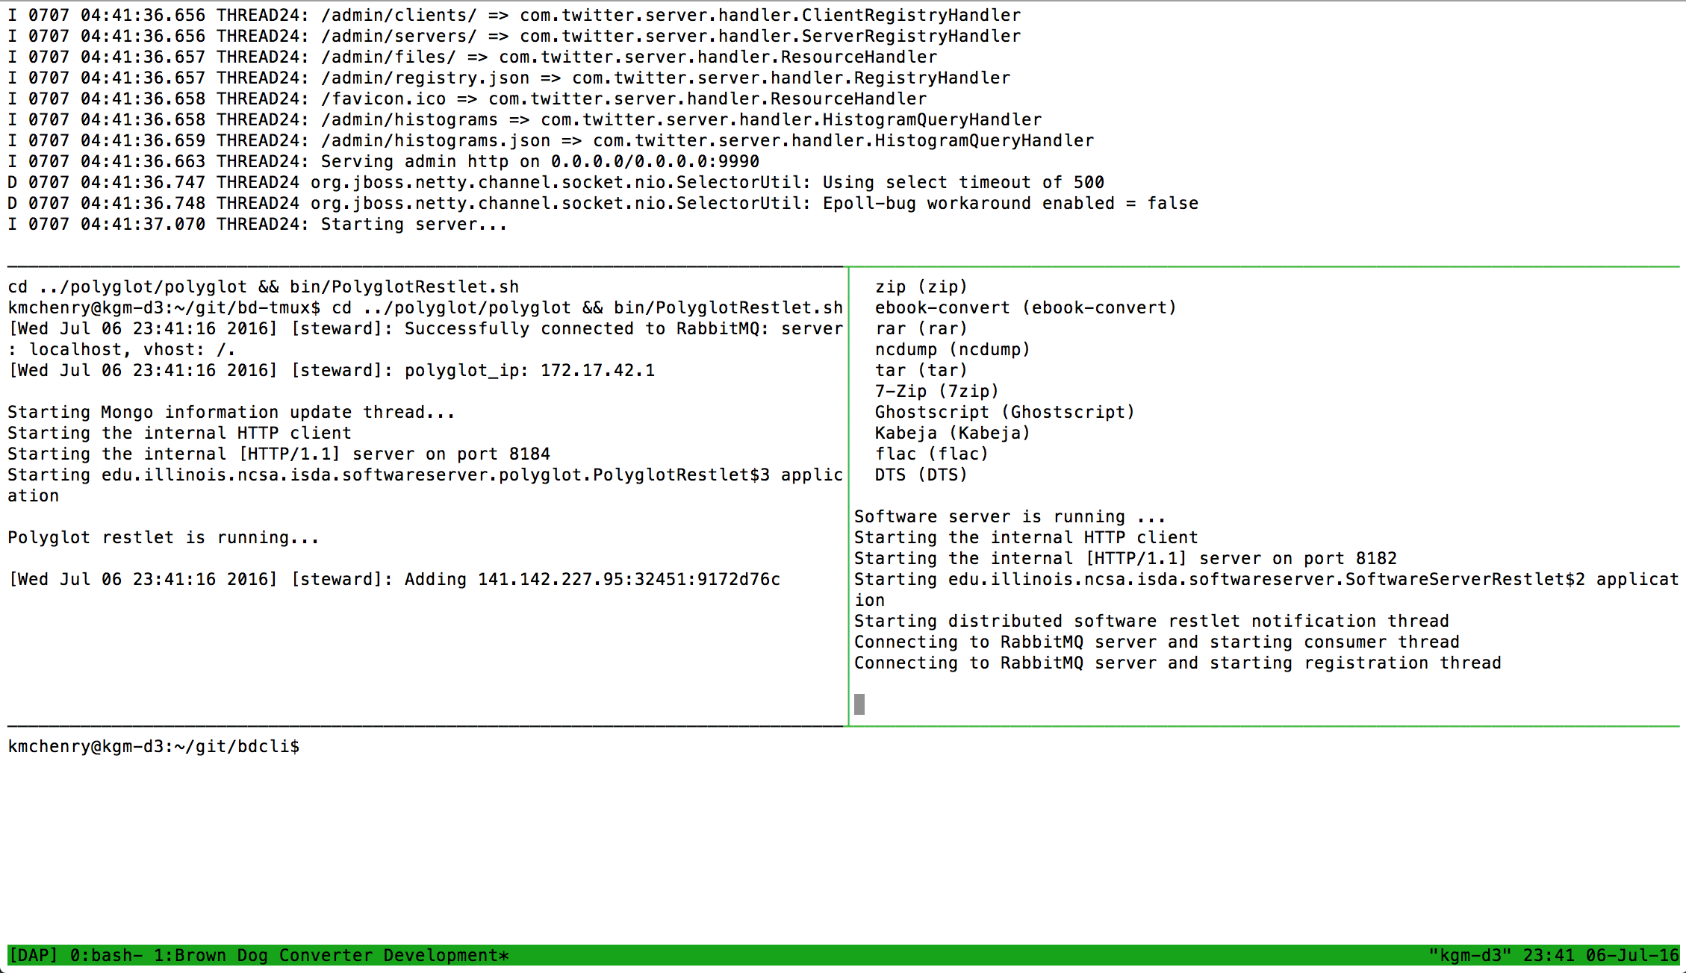
BD-Tmux
Fence
Polyglot
Software Server
Command Line Interface

Slide 9
Testing with the Command Line Interface
Either in the bottom pane or in your other terminal:
cd /home/ubuntu/git/bdcli
Generate keys for your local instance:
key_token.py
Answer the prompts:
Server [bd-api.ncsa.illinois.edu]: localhost:8080
Protocol [https]: http
Username: bdtut.user@xsede.org
Password: bdtutXy71816de
Submit a conversion:
bd –o pgm examples/IMG_0997.jpg
Check that you got a result
ls -l

Slide 10
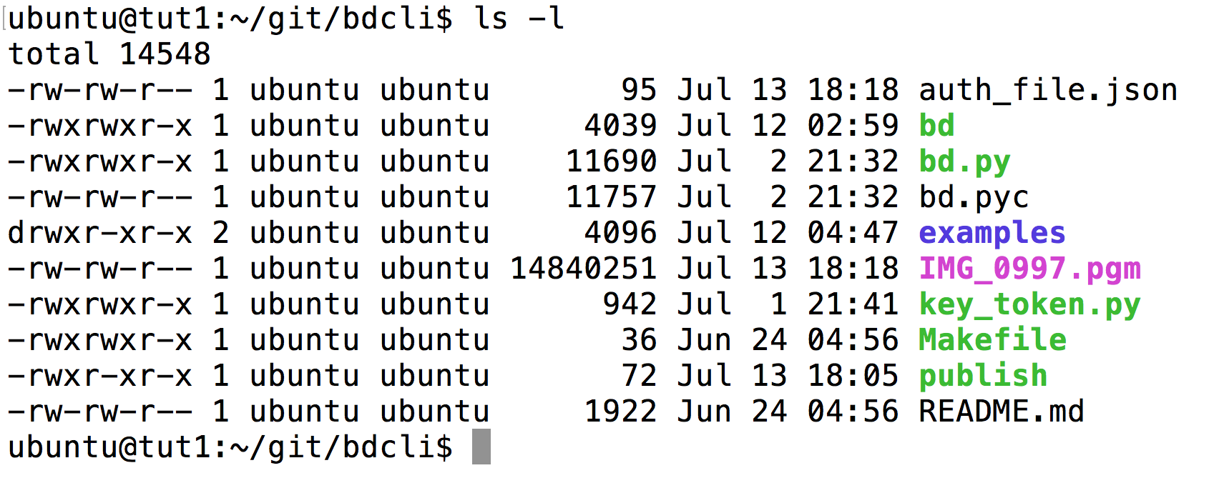
Testing with the Command Line Interface

Slide 11
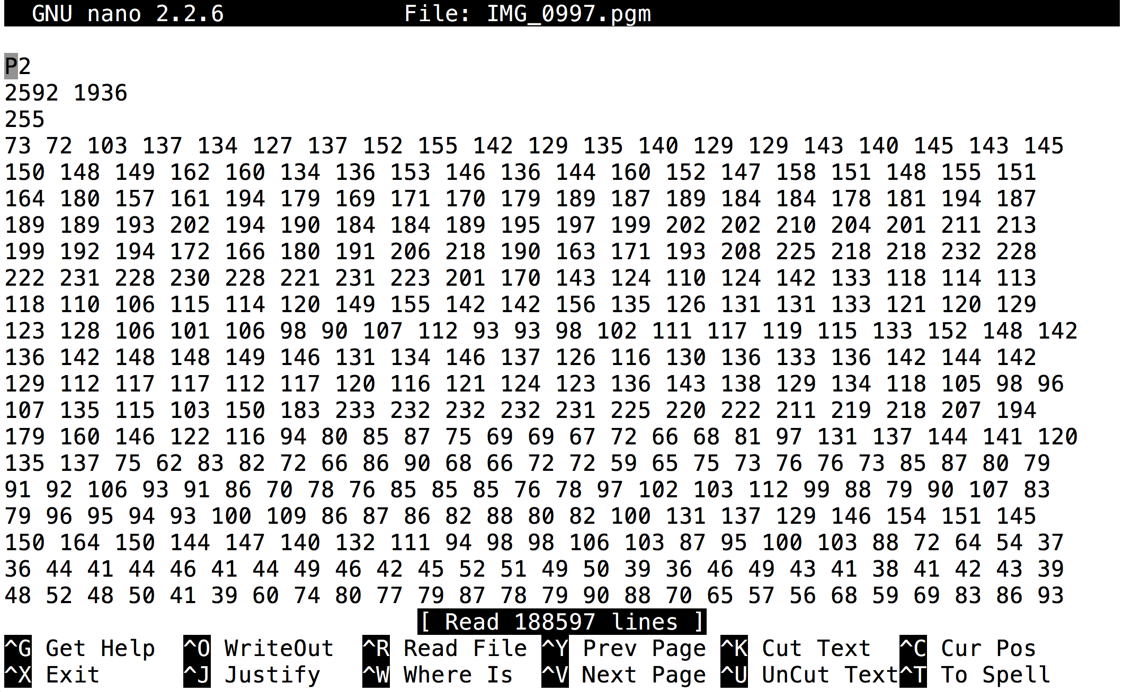
Testing with the Command Line Interface
Check that you got a result
nano IMG_0997.pgm

Slide 12
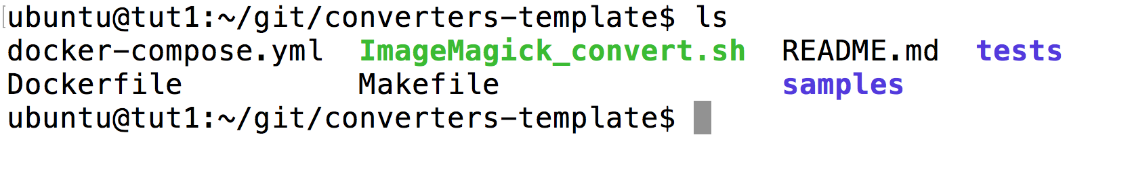
Let’s Get Started!
Again open a second Terminal to your VM
Leave the bd-tmux terminal running (this is your Brown Dog instance that you will test things against)
Lets walk through the converter template:
cd /home/ubuntu/git/converters-template

Slide 13
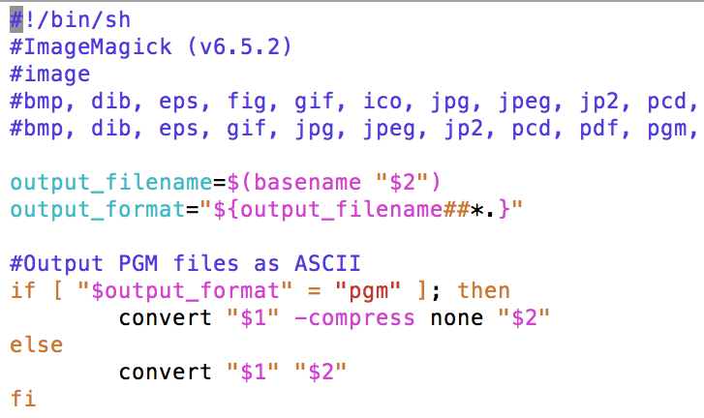
The Software Server Wrapper Script
nano ImageMagick_convert.sh
Name (Version)
Types
Input Formats
Output Formats

Slide 14
The Software Server Wrapper Script
Filename:
<alias>_convert.<script type>
Arguments:
Full local path to input file
Full local path to output file (include filename)
Full local path to available scratch space (optional)

Slide 15
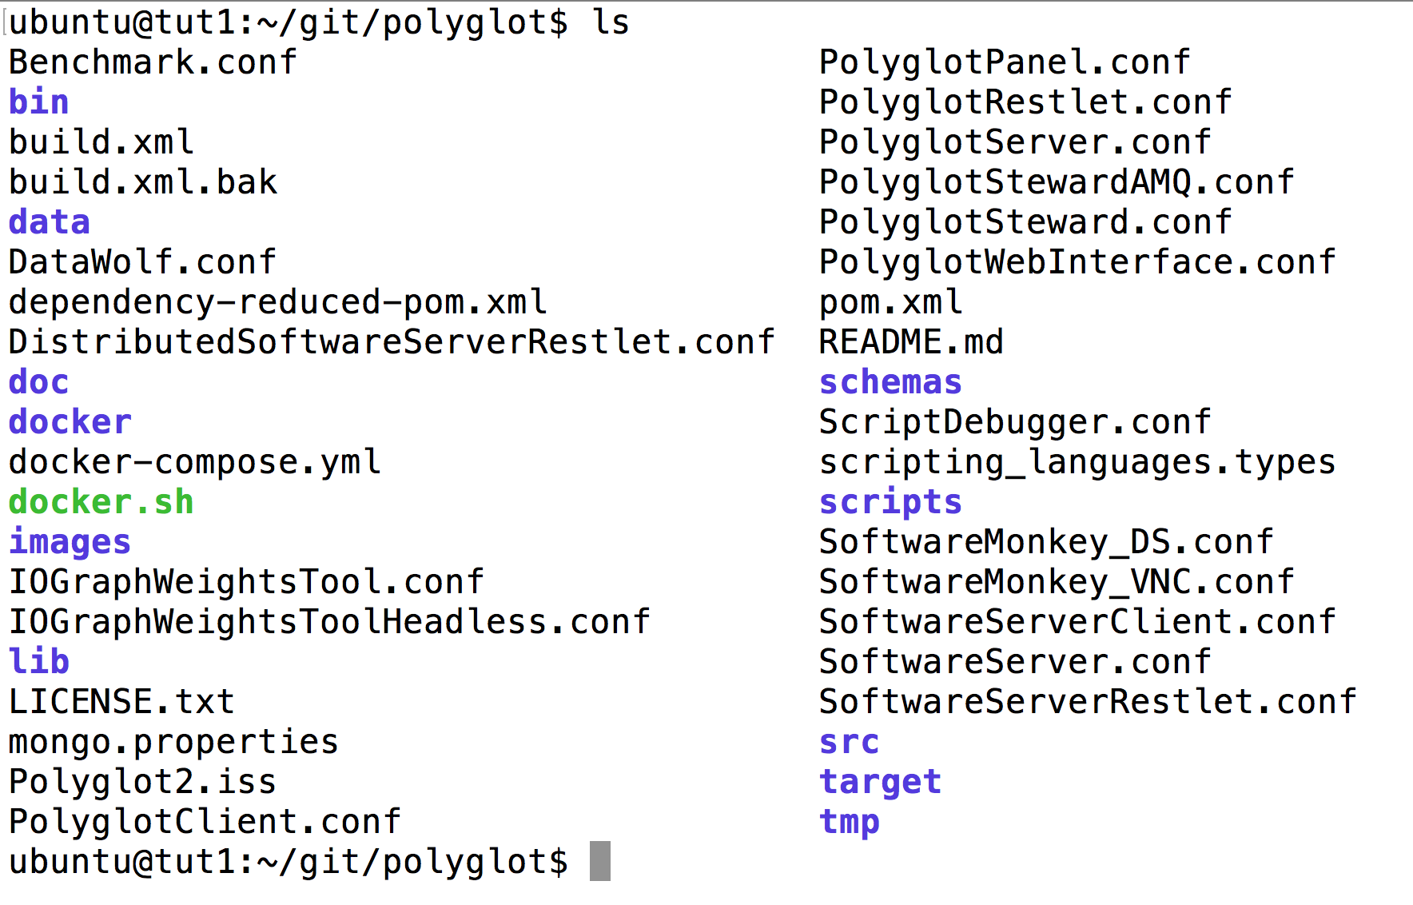
Software Server Configuration
Go to Polyglot directory:
cd /home/ubuntu/git/polyglot
ls

Slide 16
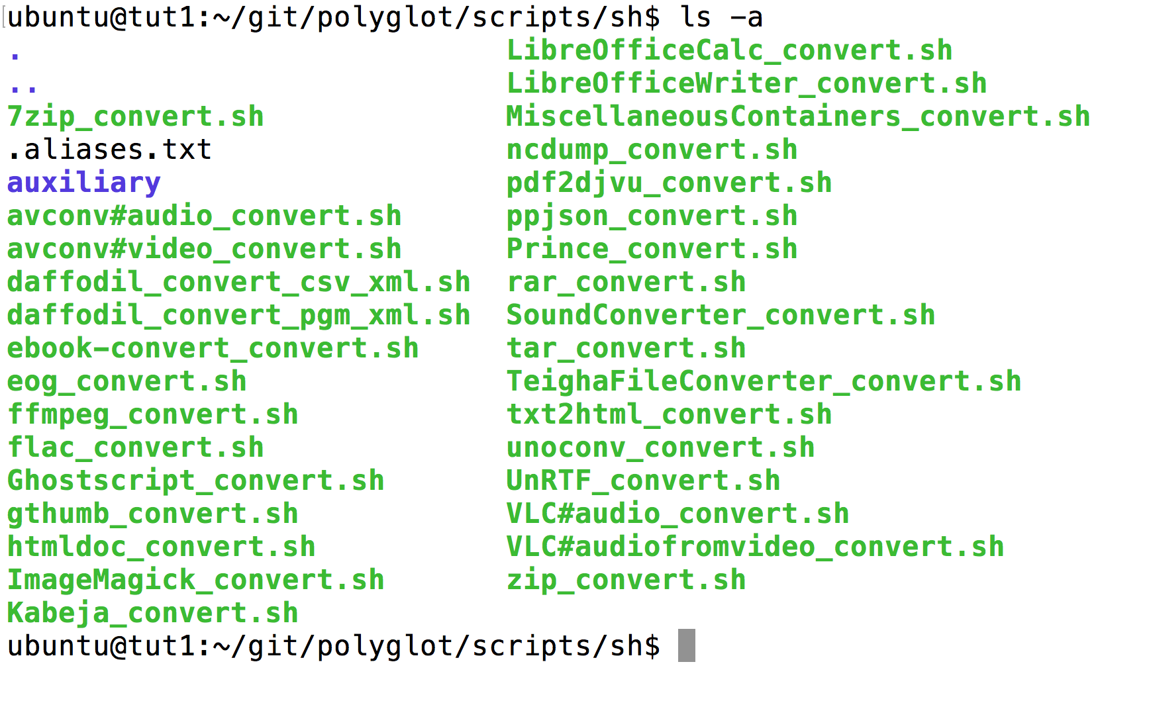
Software Server Configuration
Go to scripts directory:
cd /home/ubuntu/git/polyglot/scripts/sh
ls -a

Slide 17
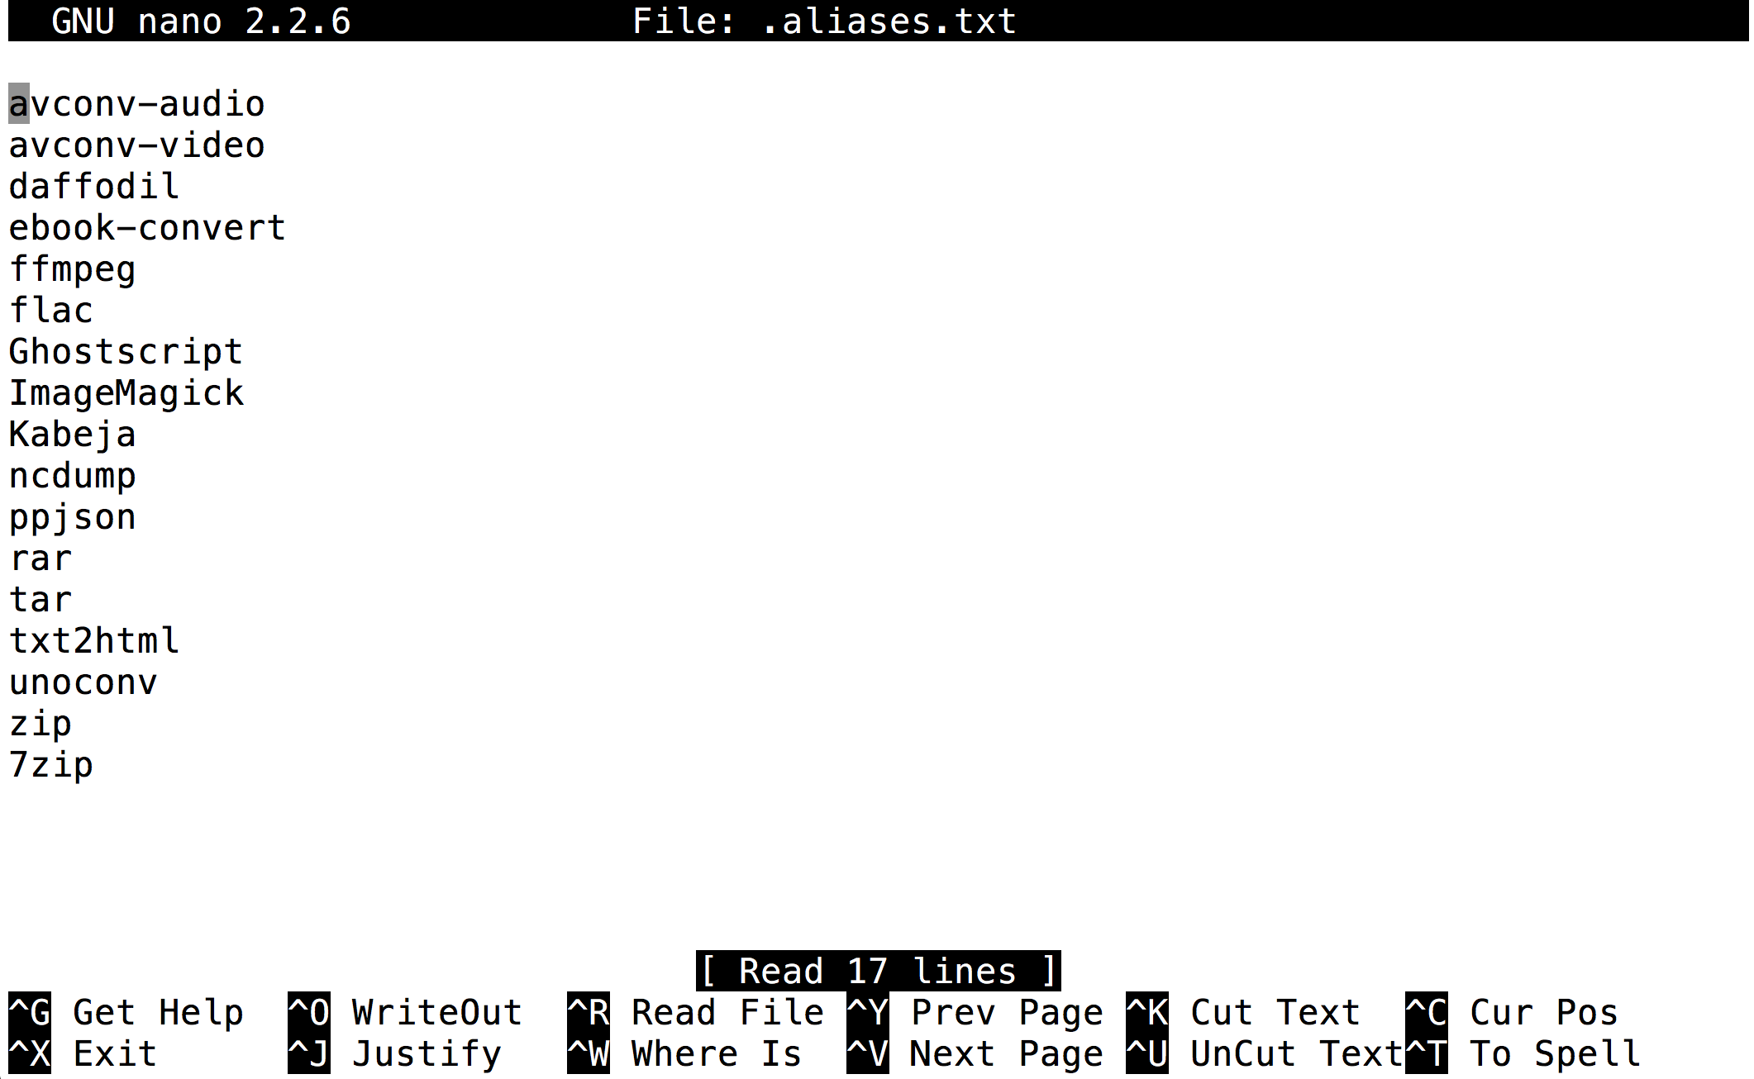
Software Server Configuration
Look at .aliases.txt file
cd /home/ubuntu/git/polyglot/scripts/sh
nano .aliases.txt

Slide 18
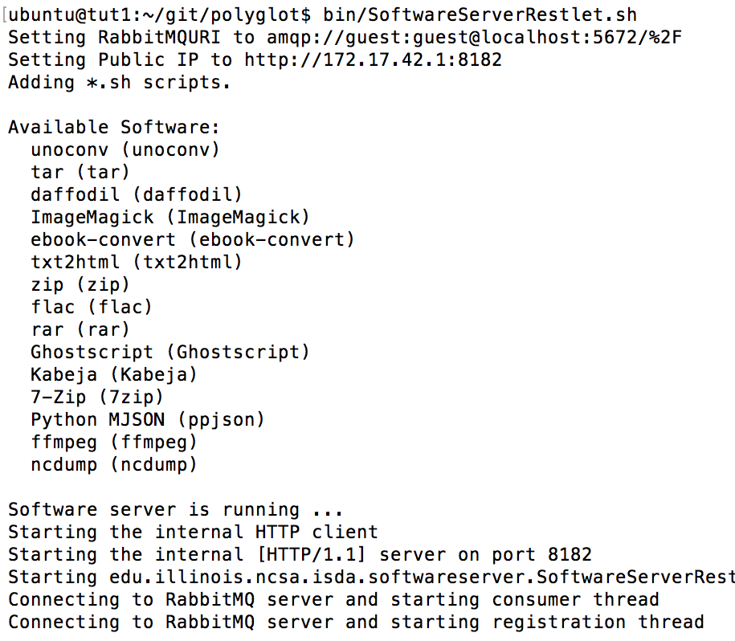
Serving the Converter
Restart the Software Server:
cd /home/ubuntu/git/polyglot/
bin/SoftwareServerRestlet.sh

Slide 19
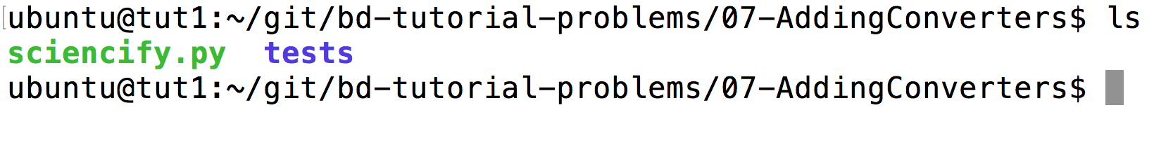
Adding a New Converter to Brown Dog
Again work in a second Terminal to your VM
Leave the bd-tmux terminal running (this is your Brown Dog instance that you will test things against)
Lets look at the tutorial folder:
cd /home/ubuntu/git/bd-tutorial-problems/07-AddingConverters
ls

Slide 20
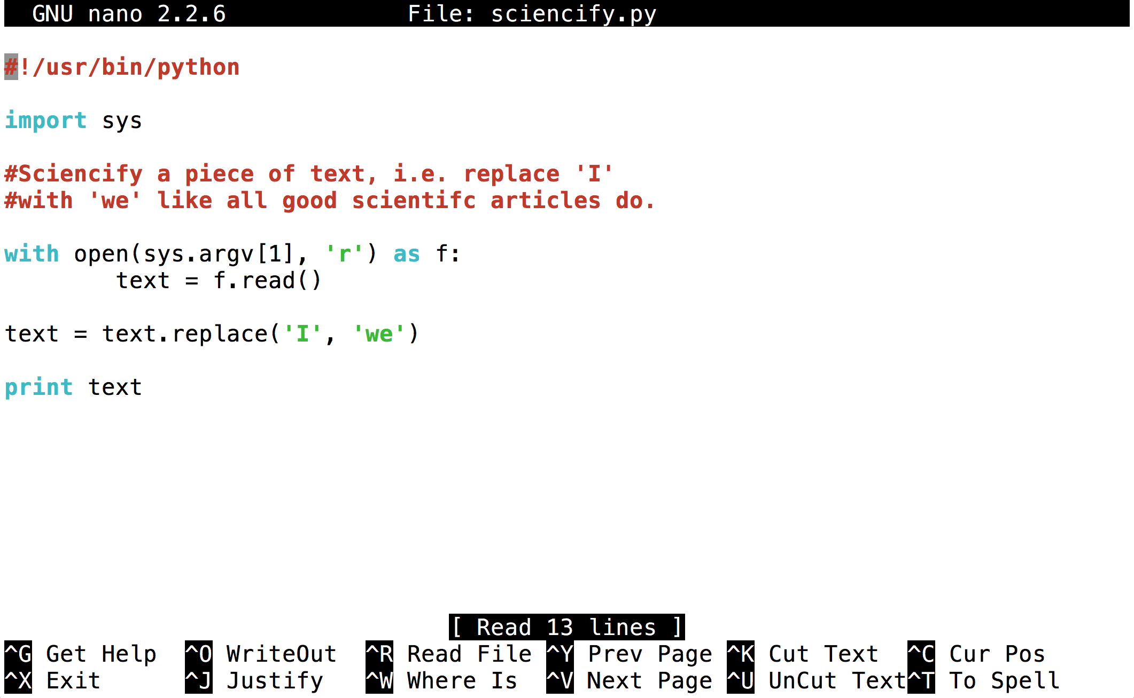
Adding a New Converter to Brown Dog
Look at sciencify.py
nano sciencify.py

Slide 21
Adding a New Converter to Brown Dog
Write a wrapper script
nano <my script>
Modify the SoftwareServer configuration
cp <my script> /home/ubuntu/git/polyglot/scripts/sh
nano /home/ubuntu/git/polyglot/scripts/sh/.aliases.txt
Start the SoftwareServer
cd /home/ubuntu/git/polyglot/
bin/SoftwareServerRestlet.sh
Test it with the BD CLI
cd /home/ubuntu/git/bdcli
bd –o <my output> examples/sonnet80.txt

Slide 22
Adding a New Converter to Brown Dog
Write a wrapper script
nano sciencify_convert.sh
Modify the SoftwareServer configuration
cp sciencify_convert.sh /home/ubuntu/git/polyglot/scripts/sh
nano /home/ubuntu/git/polyglot/scripts/sh/.aliases.txt
Start the SoftwareServer
cd /home/ubuntu/git/polyglot/
bin/SoftwareServerRestlet.sh
Test it with the BD CLI
cd /home/ubuntu/git/bdcli
bd –o science.txt examples/sonnet80.txt

Slide 23
Adding a New Converter to Brown Dog
cp /home/ubuntu/git/converters-template/
ImageMagick_convert.sh sciencify_convert.sh
Write a wrapper script
nano sciencify_convert.sh
Modify the SoftwareServer configuration
cp sciencify_convert.sh /home/ubuntu/git/polyglot/scripts/sh
nano /home/ubuntu/git/polyglot/scripts/sh/.aliases.txt
Start the SoftwareServer
cd /home/ubuntu/git/polyglot/
bin/SoftwareServerRestlet.sh
Test it with the BD CLI
cd /home/ubuntu/git/bdcli
bd –o science.txt examples/sonnet80.txt

